Slide 1
A World of MineSweeper
Holly Stein

Slide 2
Project Proposal
I would like to create a game of minesweeper with the board being a world map. Countries and oceans would be equivalent to tiles in the standard minesweeper, although I may divide the oceans so that they aren’t quite as large. To place a flag on a country, you would left-click as usual, but then would have to correctly identify the country name. This can be changed to incorporate more difficult levels that require capitals or presidents as well.
To create this project, I do not plan on using any extra technologies. I plan to write minesweeper following the same basic guidelines we followed to write the games we wrote in our homeworks. I may use classes to create countries. I will probably use a picture as my map rather than creating my own map.

Slide 3
Competitive Analysis
Minesweeper 7
Very user-friendly, shows win percentage which is nice. I would like to include percentages and make it user-friendly
Minesweeper 8
Very frustrating, very slow, does not show win percentage
There are a number of variations available, I would like to make different variations, maybe an option to focus on specific regions,
Pandemic: world view, kind of like risk
I like the clean view of the world, there is a sidebar that prints world updates
The navigation is not intuitive, I would like to make the navigation similar to google maps, although I’m not sure how difficult it would be to allow the click and dragging feature
Crazy minesweeper
I like that it is like windows 7 version
Clear instructions, this is a must, they must be accessible throughout the game
You can’t change the window size from the corner

Slide 4
StoryBoard
where you include hand-drawn pictures (do not worry about making them pretty) showing how your app will work from the user’s perspective. Using your storyboard, you will walk your mentor through the user experience of your program, and you will do this prior to writing lots of code. This way, your mentor can help you make any necessary adjustments to your design prior to your having a huge investment in a large code base.

Slide 5
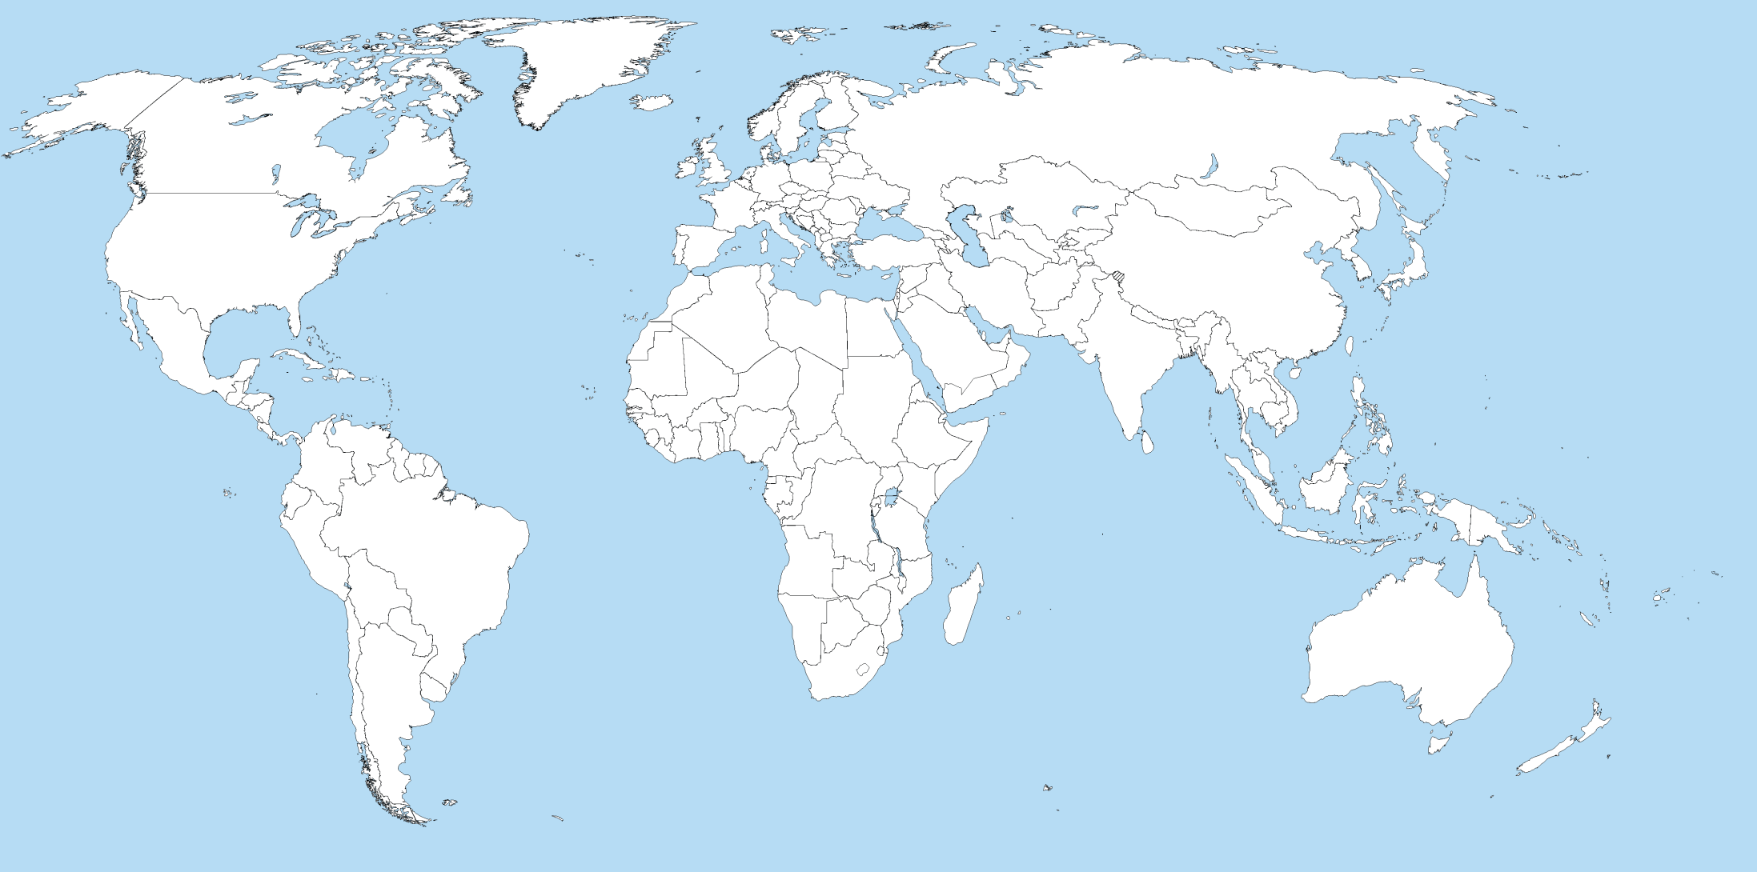
File | Edit |View | Help
Pop Up
This is how you play the game

Slide 6
File | Edit |View | Help
Click!

Slide 7

Play the game like minesweeper, where the mouse buttons have the same functions
File | Edit |View | Help
1
2
1
1
1
1
1
Notes:
This looks like it will be harder than regular minesweeper, unless I have too many bombs in my sample (which is the case)

Slide 8
Right Click: pop up
File | Edit |View | Help
Pop Up
Which country is this? (select one)
Burma
Libya
Canada
Algeria
1
2
1
1
1
1
1
If the correct answer is selected (Algeria in this case), the game continues, otherwise it goes to game over.

Slide 9
File | Edit |View | Help
x
x
x
x
x
x
x
x
x
x
x
x
x
x
x
x
x
x
x
x
x
Notes:
Maybe it would be better to make this a treasure hunt rather than a world full of bombs. Or at least provide that option.

Slide 10
File | Edit |View | Help
x
x
x
x
x
x
x
Game Over/You won!
Fun fact about the world
x
x
x
x
x
x
x
x
x
x
x
x
x
New Game
Statistics
x
Notes:
Maybe it would be better to make this a treasure hunt rather than a world full of bombs. Or at least provide that option.

Slide 11
Notes:
Classes to store data
A place to click in each country so you don’t have to outline each country (first invisible squares)
Start with just Europe
Zooming – you can’t use the canvas’ coordinates, you have to write them so that they work for different canvas sizes
- or you can drag, displace the view by an offset of the corner

Slide 12
Any Code?
Not yet

